Slide 1
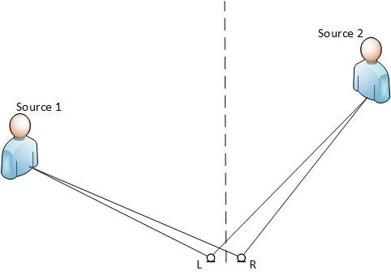
Directional filtering

Slide 2
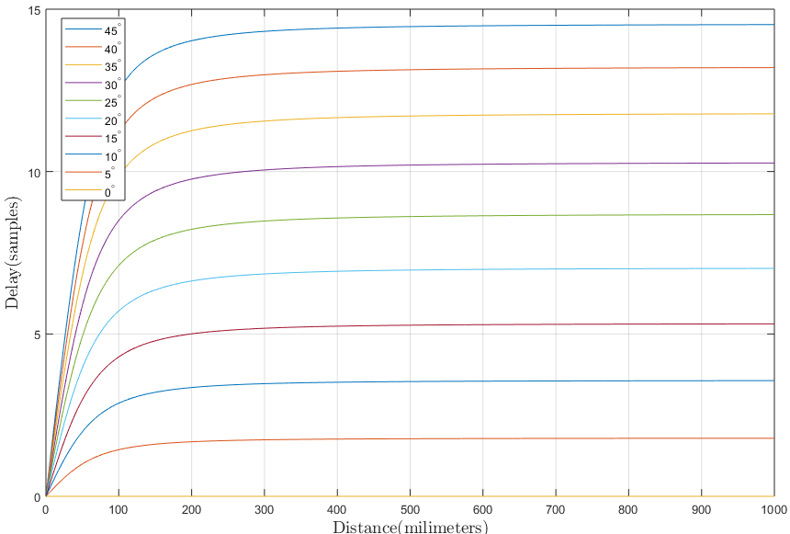
Distance effect on delay

Slide 3
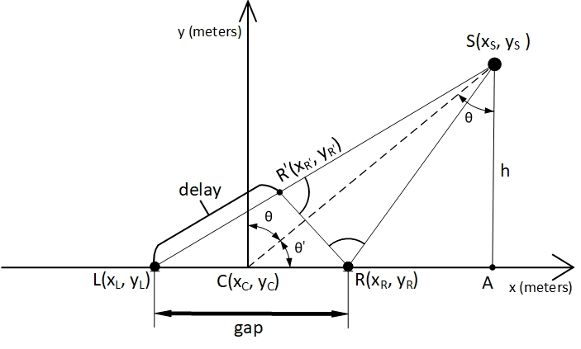

Math
$$SR=\sqrt{{\left(\sin\left(θ\right)∙CS−\frac{gap}{2}\right)}^{2}+{\left(\cos\left(θ\right)∙CS\right)}^{2}}$$
$$delayInSamples=\frac{SL−SR}{v_{s}}∙f_{s}$$

Slide 4
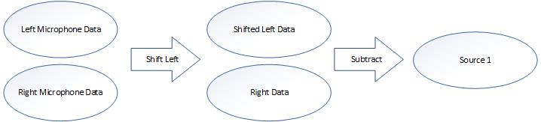
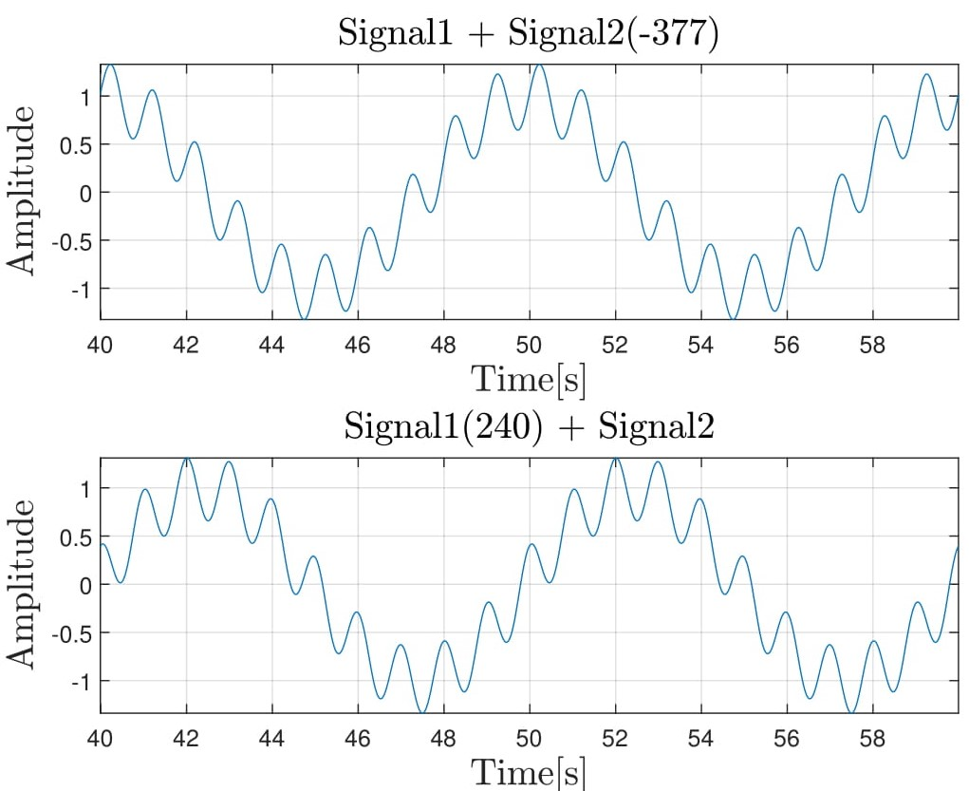
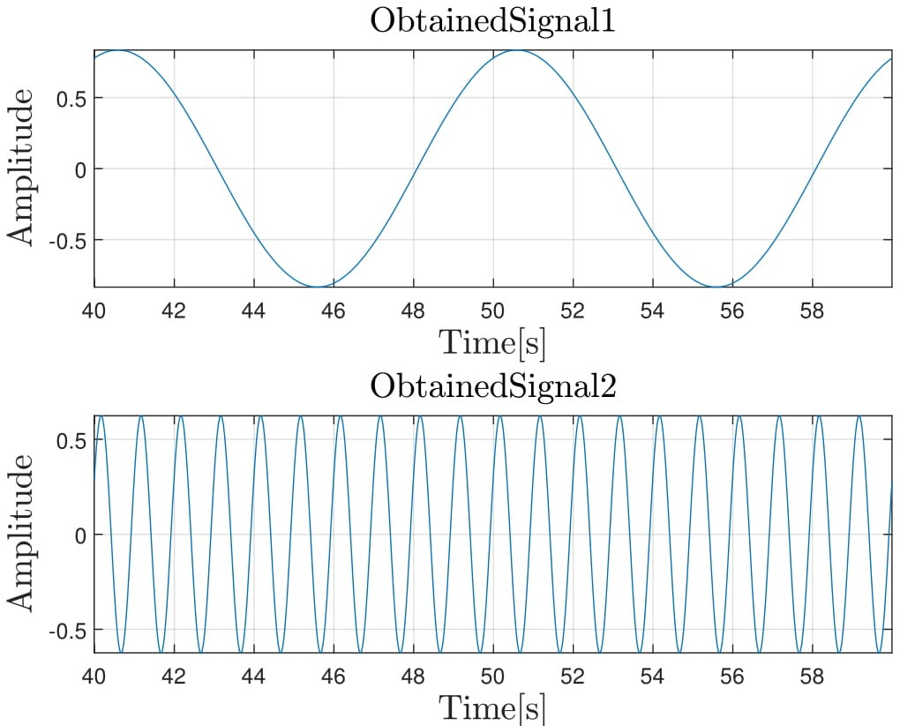
Filtering Idea

Slide 5
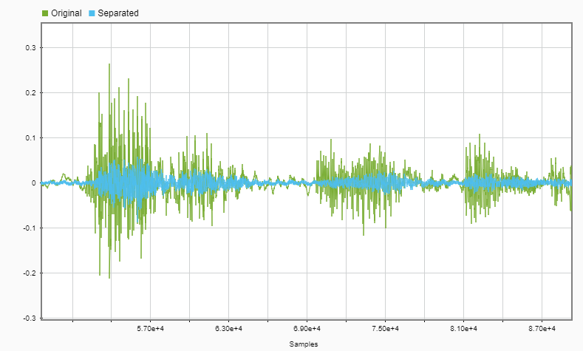
Examples
Single source filtering

Slide 6
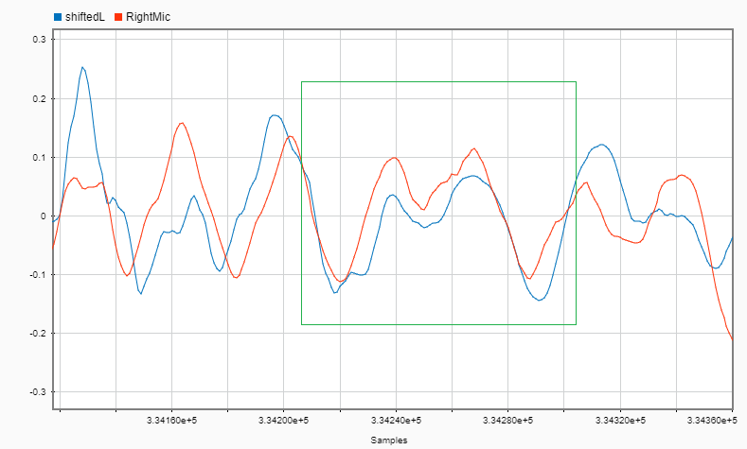
Two sources filtering

Slide 7
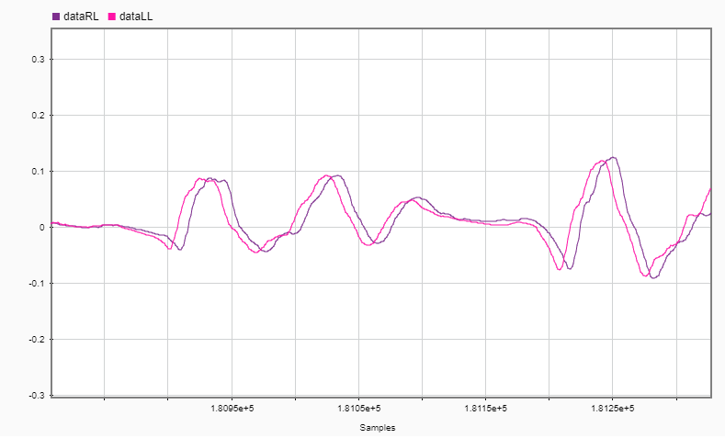
Synthesis

Slide 8
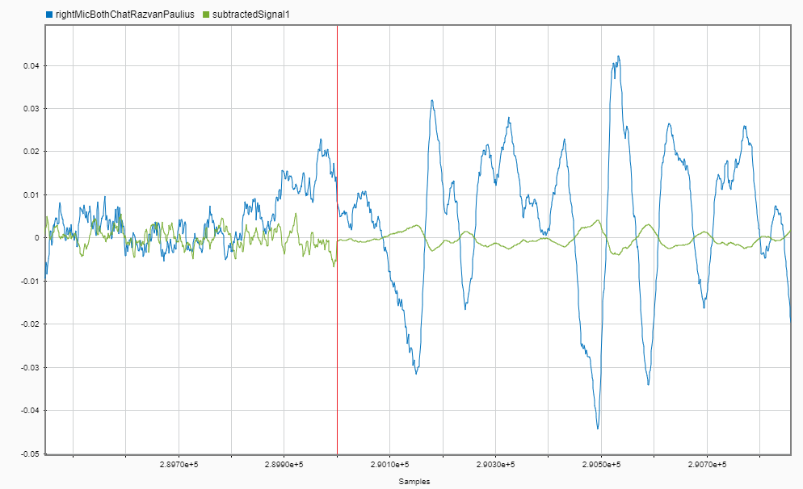
Results

